Slide 1
Scheduling Exams with SAC Testing Center
AIM Software

Slide 2
Schedule Exams in AIM
Before you schedule an exam:
Be sure the letter of accommodation for that class has been approved and sent.
Plan ahead. SAC Testing Center needs 4 business days prior notice to approve scheduled exams/quizzes and 10 business days to approve finals.
Know if your instructor proctors the exam in the department, or the exam is unproctored. You do not schedule these exams in AIM.
Plan ahead and submit all exam dates including the final at the beginning of the semester.

Slide 3
Overview of Steps to Schedule an Exam
Log into AIM:
Click "Alternative Testing" on left sidebar
Select course from drop down menu
Click "Schedule Exam"
Complete "Exam Details"
Click "Add Exam Request“
Tips:
Letter of accommodation must be approved and sent before scheduling exams
Submit exam requests for the whole semester
Keep track of your exam requests: log into AIM; click Alternate Testing

Slide 4
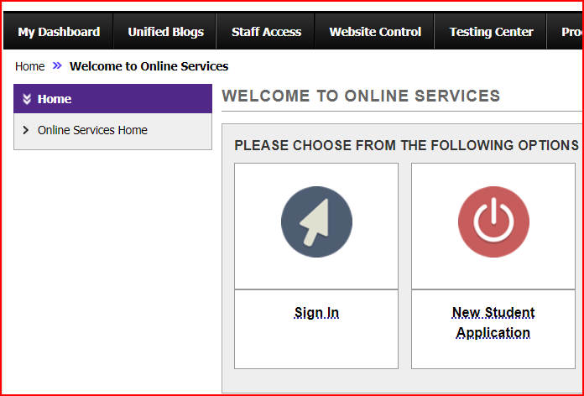
AIM Log In
Log into AIM
EID and password required

Slide 5
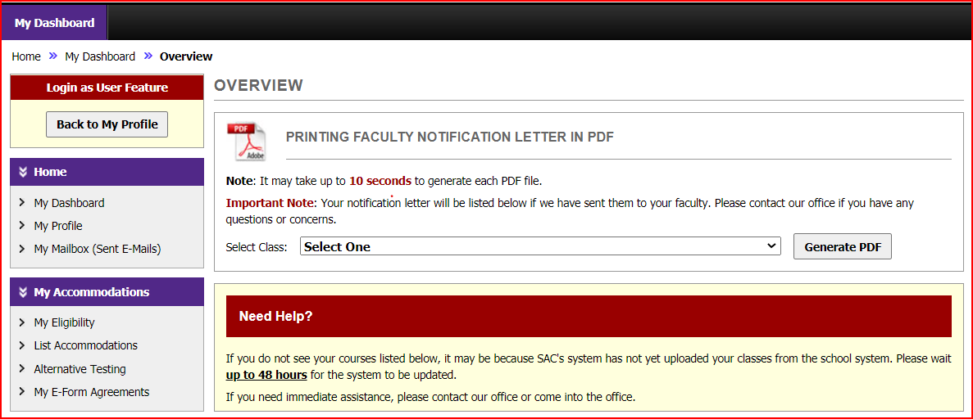
AIM Dashboard
AIM will open with My Dashboard showing all the classes for which you have requested accommodations.
On the left sidebar under My Accommodations click Alternative Testing.

Slide 6
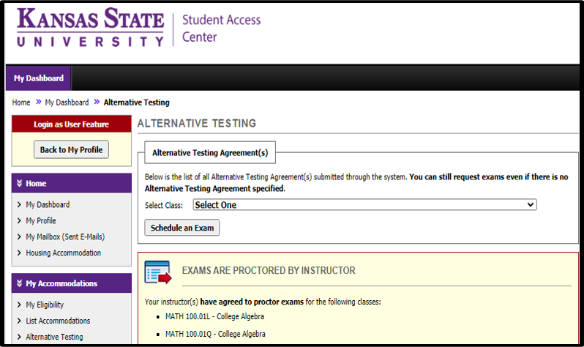
AIM Dashboard (Cont’d)
From the dropdown menu select which class you need to schedule an exam.
Click Schedule an Exam
Notice:
Do not schedule the following:
Exams proctored by instructor
Unproctored exams
Global Campus exams

Slide 7
AIM Dashboard (Cont’d)
After you submit your request:
A message box will let you know if you have made an error, or you have been successful.

Slide 8
SAC Testing Center Contact Information
Email: tst@ksu.edu
Phone: 785-532-6441
Hours: Monday – Friday 8:00 – 5:00
If possible, please leave personal belongings at home.

